Slide 1
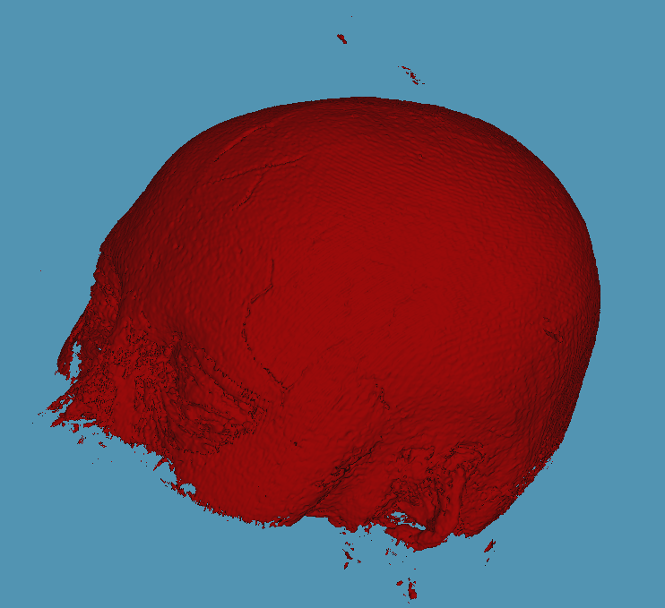
Medical Image Processing
Week 11 Exercise -
Volume visualization techniques
Matlab, 2023
Enxi Li
Hatipoglu Osman Rodrigues Isabela
Yan Yan
Notes:
Present myself - Group 11.

Slide 2
Task description
– Display the surface of the patient in the given MRI DATA
– Visualize data using Isosurface and Point Cloud and surface rendering.
– Explain which pre-processing steps and parameter choices are required.
– Compare surface rendering visualization with a volume rendering.
– Present the main functions used in the script.
Purpose and
DATA
Visualization methods
Notes:
displaying - DICOM dataset in an Isosurface and point cloud viewers + surface rendering techniques - preprocessing steps. To end up comparing - volume rendering visualization.

Slide 3
Volume Visualization
Graphical representations on 3D grids.
Two basic type of volume data = Scalar or Vector data.
Techniques choice depend on what you have and what you wanna learn.
Visualization techniques = Surface and Volume rendering.
Determine the characteristics of your data
Select an appropriate plotting routine
Define the view
Add lighting and specify coloring
Notes:
Visualization is very important in medicine, generally in patient care. Since it is an interplay of data and design is used to communicate data, it must be efficient and clear to do so. DATA (2D, 3D), it's purpose (display) and its visualization methods. And volumetric visualization -extract meaningful information from volumetric data using interactive graphics - representation, manipulation, and rendering of volumetric datasets.

Slide 4
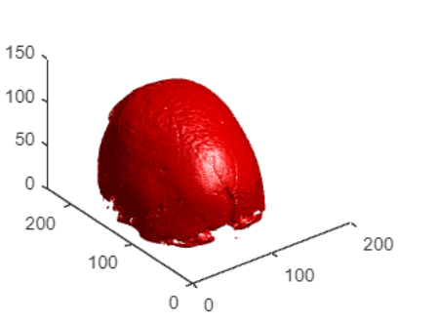
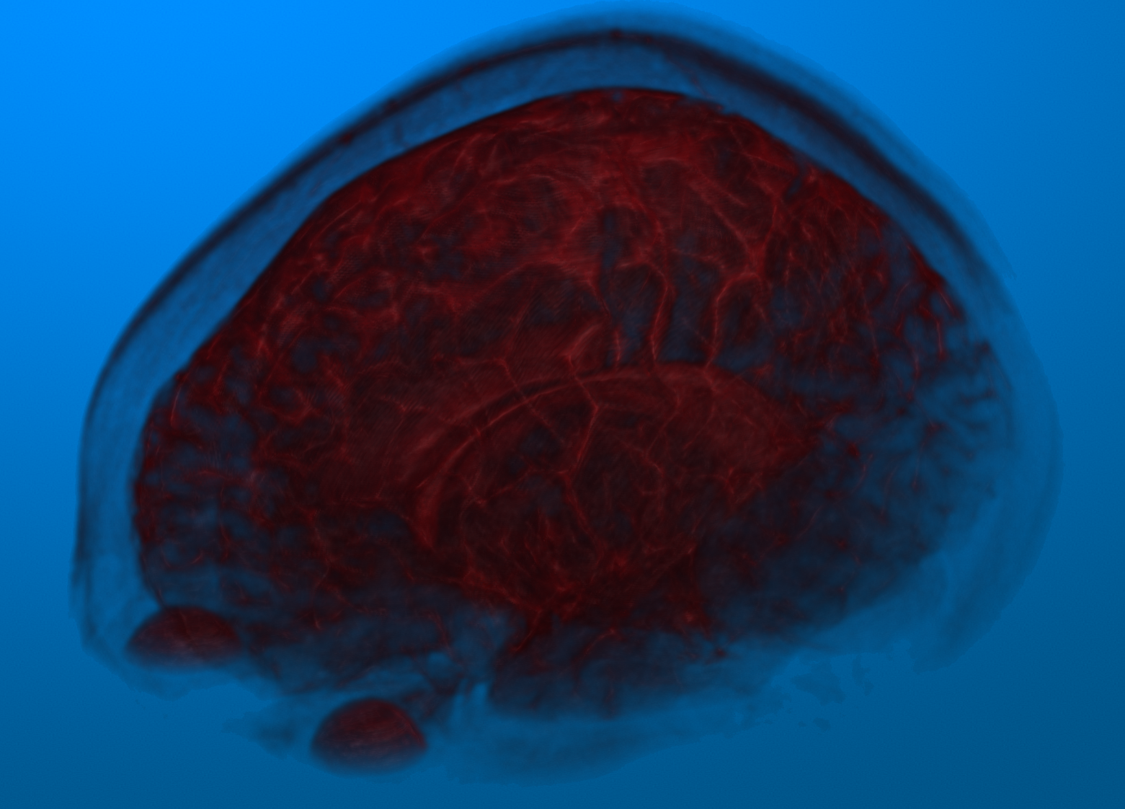
Visualization methods - Display 3-D Medical image Data
Surface rendering
“... relies on determining the surface in advance. »
Volume rendering
“... classifies relevant info, specifically colors and opacities, and assigns them to voxels based on information about them.”
HEAVY.AI and MATLAB, 2023
Notes:
There are two different approaches - depending on how much of the volume raster set is rendered: Surface rendering or indirect rendering focuses on data's outer boundaries and features performing a segmentation and then making a 3D Model out of it, while volume rendering or direct rendering better understands internal structures. Again, the data depends on the purpose of the visualization.

Slide 5
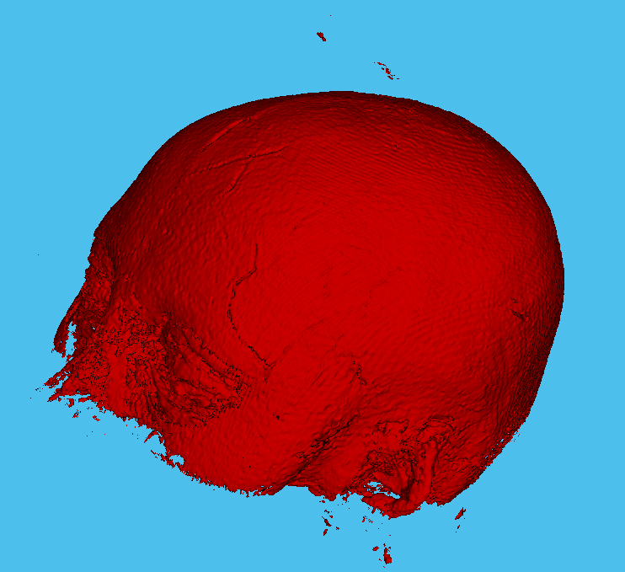
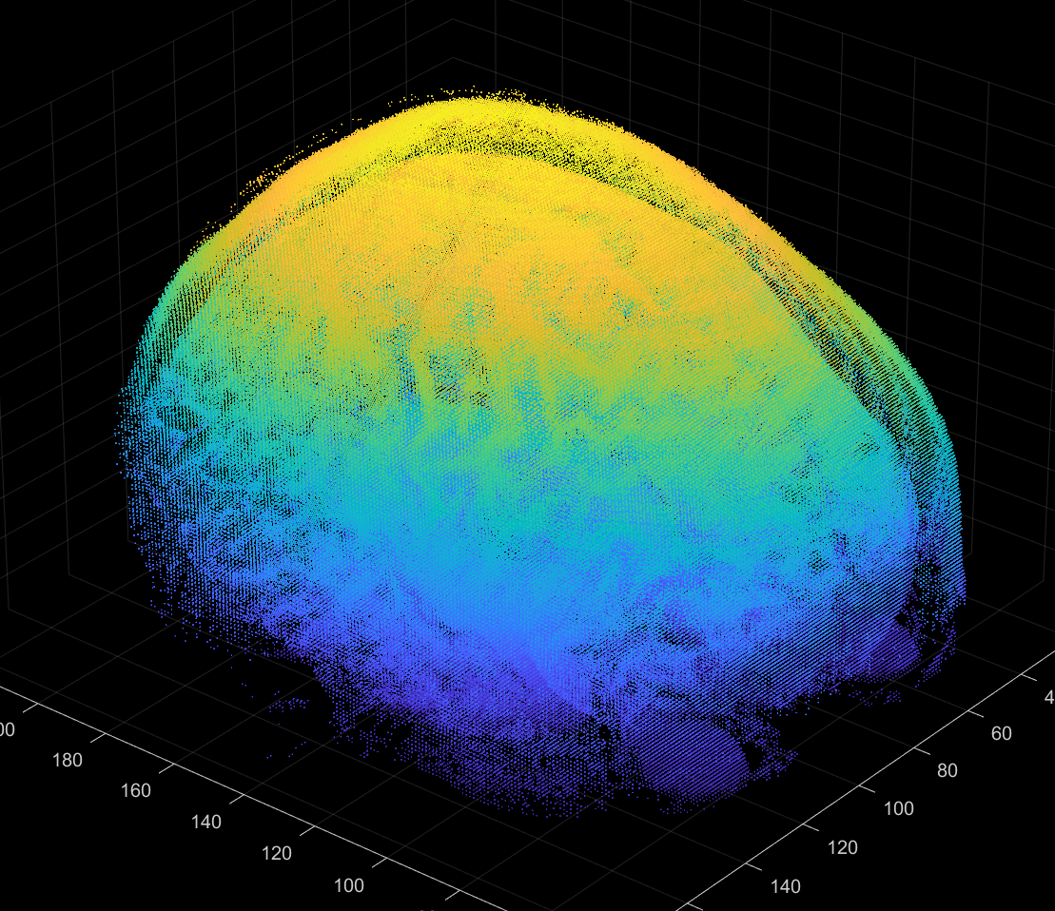
Computer techniques - functions
Iso-surface
Meaningful iso-value.
Polygonal mesh surface.
Interest in boundary regions.
Application example:3D MRI DATA.
Point cloud
“Defining a coordinate system (x,y,z).”
Application example: density 3D CT scan
and internal organs and bones.
Matlab, 2023
Matlab, 2023
Notes:
Along with these methods we have some computer techniques that are used in combination with Surface and Volume rendering. So, if I have a 3D scan that I need to define the density value of the points in space, with Isosurface we can show where the density changes to then be able to highlight like a specific organ for example. This technique focuses on brightness, gradient and texture. In the case of a point cloud, it focuses on a discrete set of data points in space. If we have a 3D Map created by a bunch of detail points from a body scan, we want to show personalized views of body organs for example. This point cloud can help, and it adapts the visualization nicely and is good for complex cases.

Slide 6
Isosurface or Iso-Surface - main functions
Squeeze the data
disp(size(dicomVolume4D));
% This is a 4D dataset [256 192 1 128], so we have to squeeze it into 3D data
volume3D = squeeze(dicomVolume4D);
Apply a noise reduction filter
% Here we use a median filter which can retain the edge information
denoiseImage=medfilt3(volume3D,[3,3,3]);
Isosurface
[f, v] = isosurface(denoiseImage, isovalue);
% “f” refers to face; “v” refers to vertex%
% use face-vertex meshes to store polygon meshes to achieve surface rendering
The isovalue will influence the visualization
Notes:
For the Isosurface script, this is a 4D dataset, so we had to squeeze it into 3D data. The third dimension is 1. This means we do not need to keep this dimension. So we can just "squeeze" this dimension to make operations easier. And related to isovalue, it will influence the visualization. But how?

Slide 7
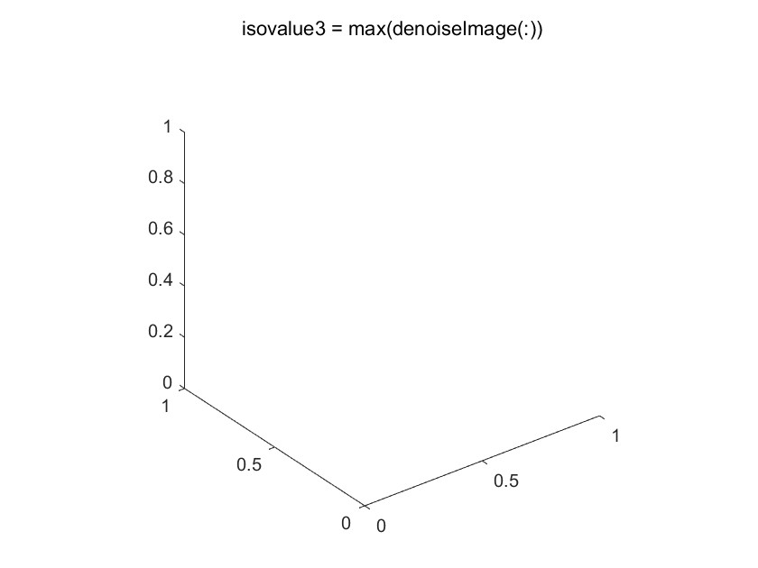
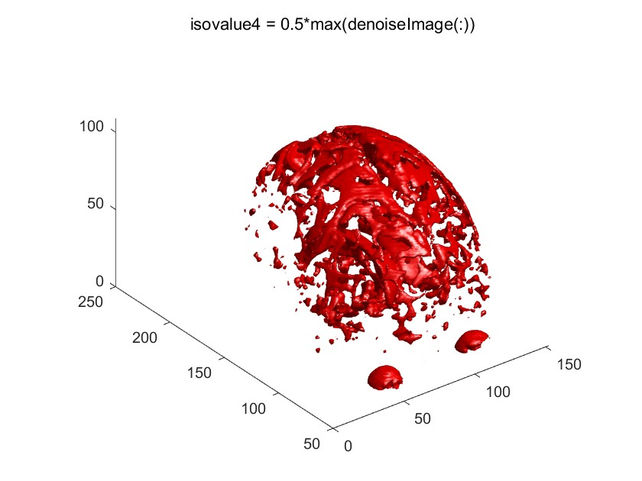
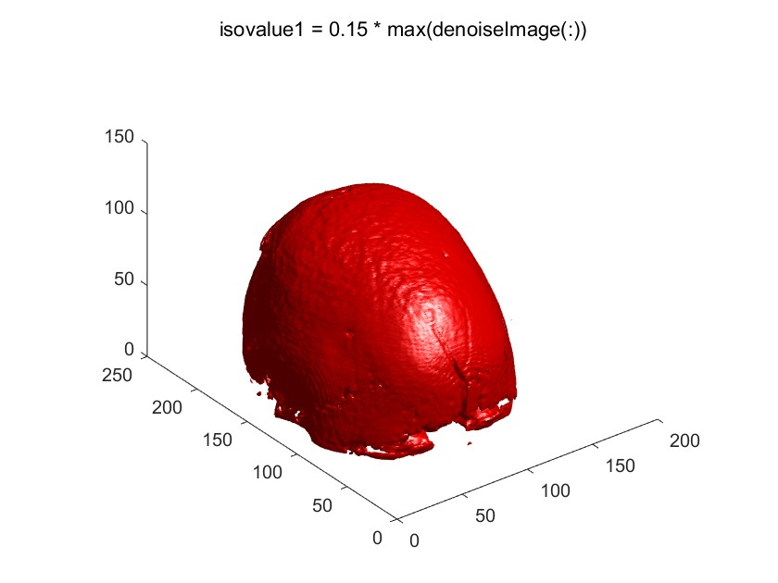
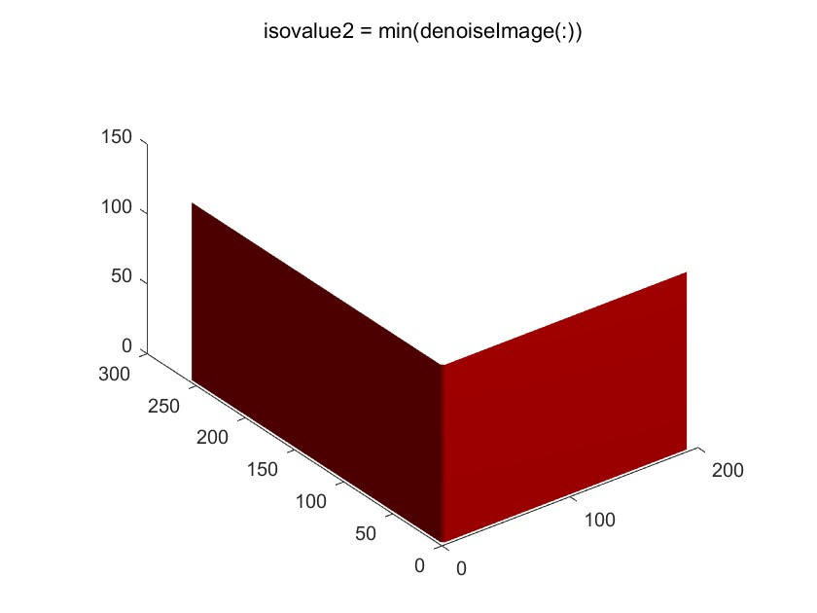
The isovalue will influence the visualization
Matlab, 2023
The isovalue is too low
The isovalue is too high
The isovalue is a bit high,
so it can`t show the whole structure
The output seems to be better
Notes:
Here we can better see how this iso value can affect the display of the picture. If too high, no data is displayed and if too low, the image loses its shape and purpose. The last image is the value chosen as isovalue of 0.15.

Slide 8
Point cloud - main functions
The region shown varies
with the threshold
Find points above the threshold to show our target region
pointsIdx1 = find(volume3D > threshold1);
Convert indices to coordinates of points
[x, y, z] = ind2sub(size(volume3D), pointsIdx);
Create the point cloud using the coordinate dataset
ptCloud = pointCloud([x, y, z]);
Notes:
For point cloud, we had to find points above threshold to show our target region, then convert these indices to coordinate points and create the point cloud.

Slide 9
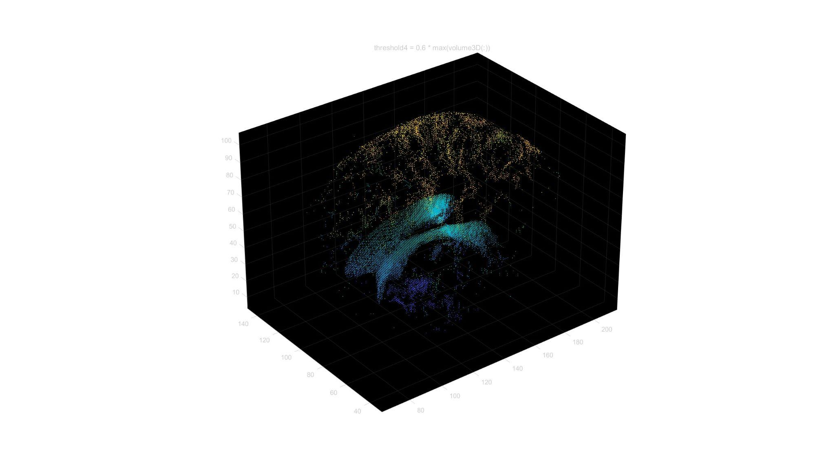
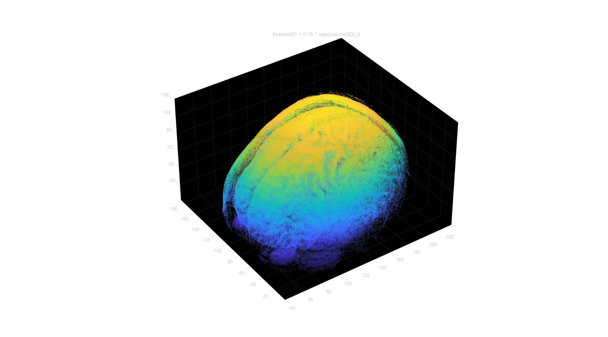
The region shown varies with the threshold
Matlab, 2023
"threshold4 = 0.51 * max(volume3D(:))"
"threshold4 = 0.15 * max(volume3D(:))"
Notes:
Here we can see a comparison of values for the region shown of 0.51 and 0.15

Slide 10
Then we use some additional preprocessing steps to remove the skull to directly view the cortex.
Notes:
Then we use some additional preprocessing steps to remove the skull to directly view the cortex.

Slide 11
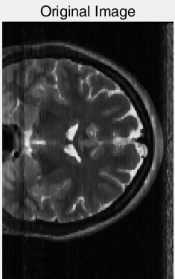
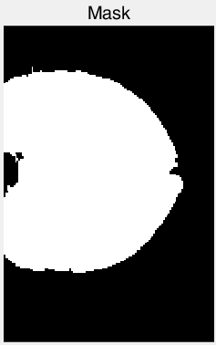
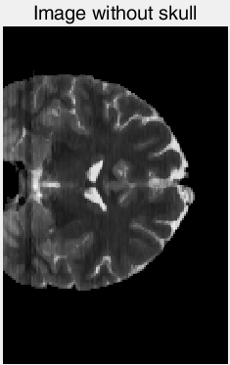
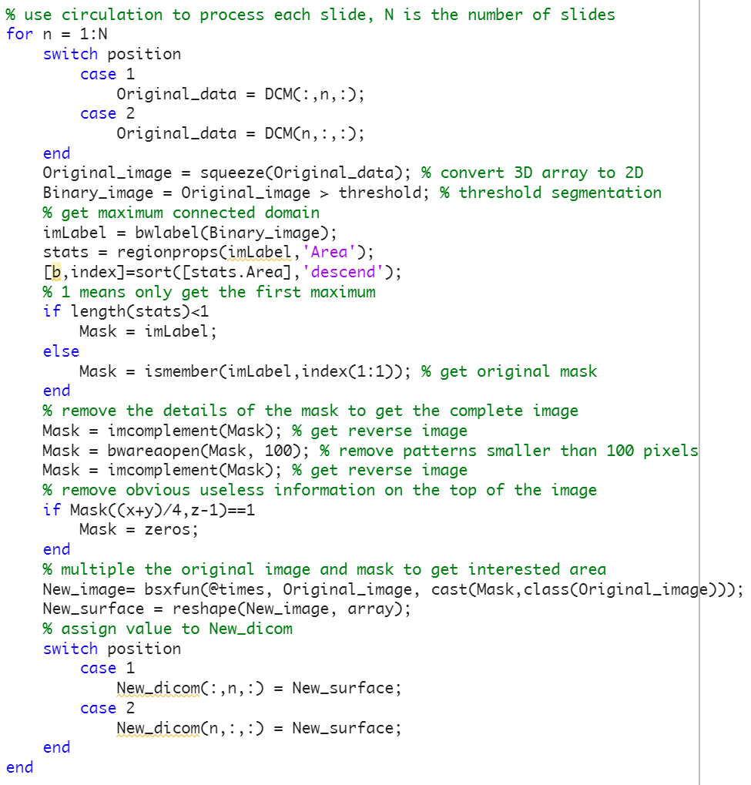
Main principle of removing skull
get mask of interested area
multiple mask and original image
Matlab, 2023
Notes:
So, we used a mask to get our area of interest and after we multiplied the mask and the original image.

Slide 12
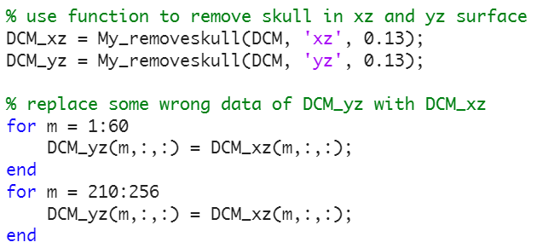
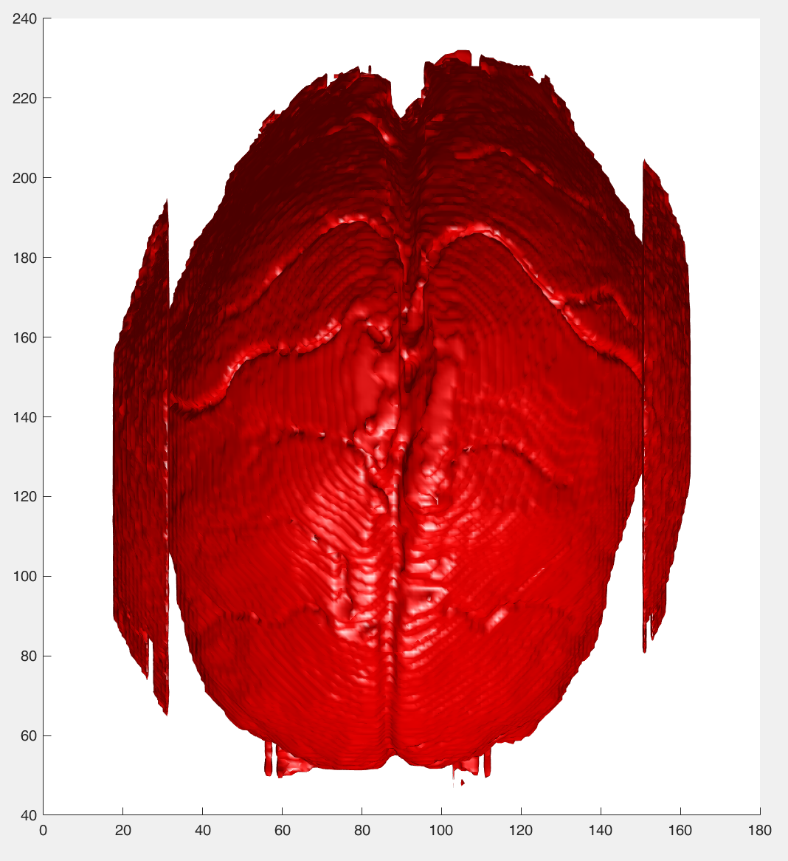
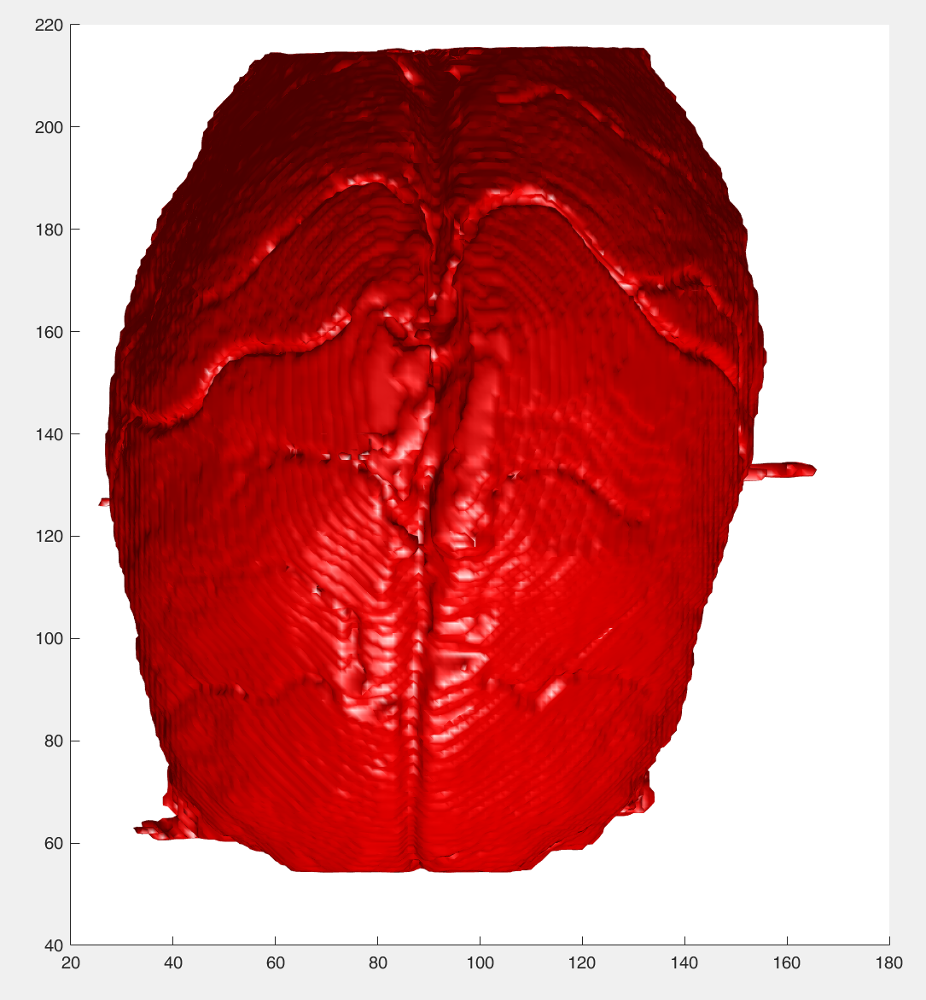
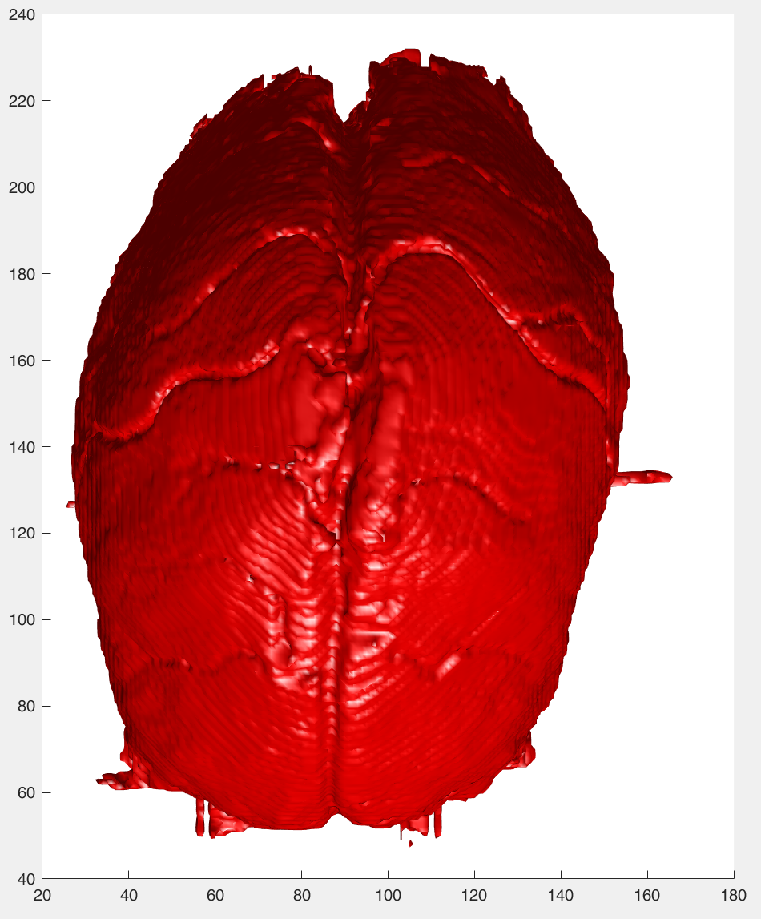
Main principle of removing skull
process by xz surface
process by yz surface
combine them
Matlab, 2023
Matlab, 2023
Matlab, 2023
replace data of yz result with xz result in two areas
Notes:
Simple replace.
*The two results weren’t perfect and the areas were different.

Slide 13
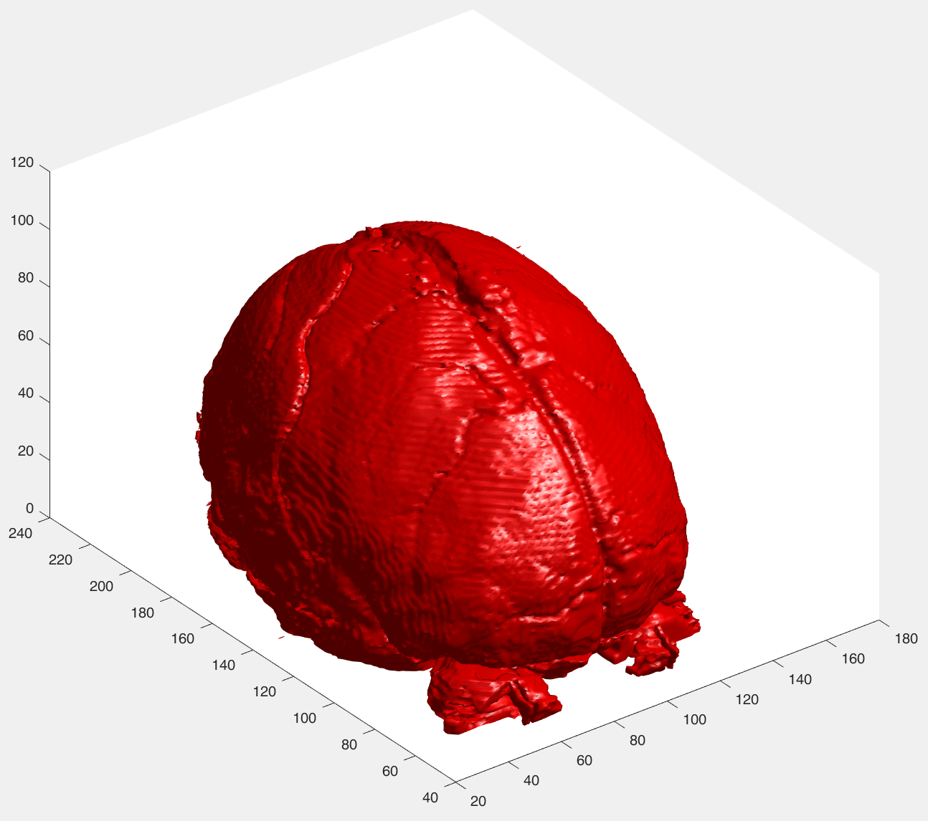
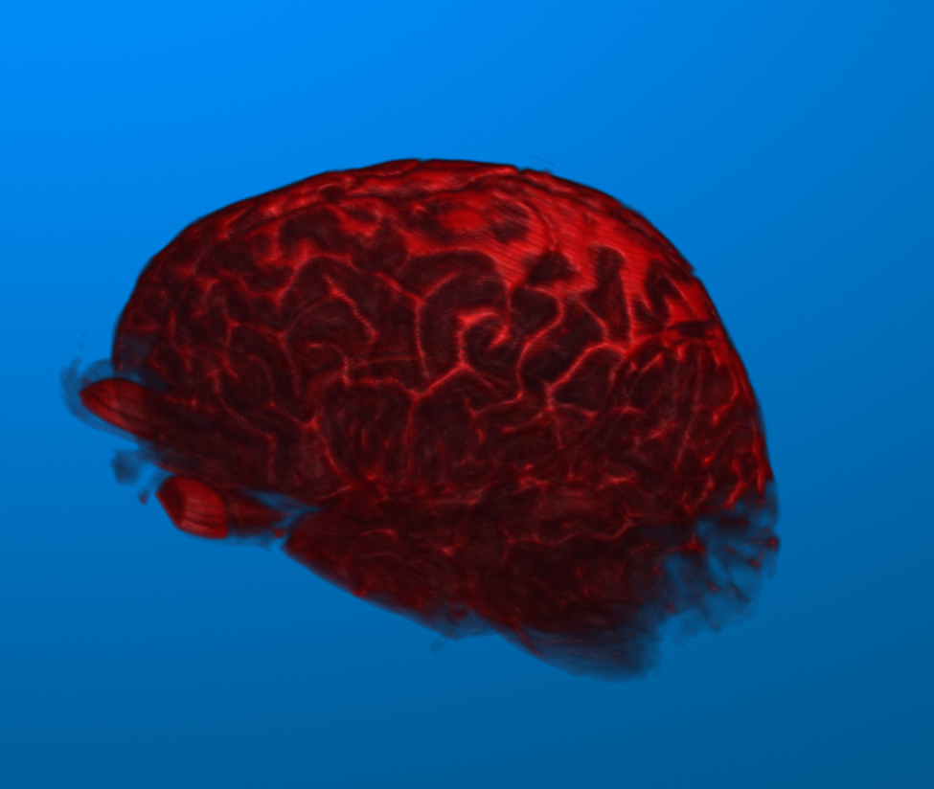
Results without skull
Surface Rendering
Volume rendering
Matlab, 2023
Matlab, 2023
Notes:
In the end our results were this two images - illumination model - semi-transparent voxels.

Slide 14
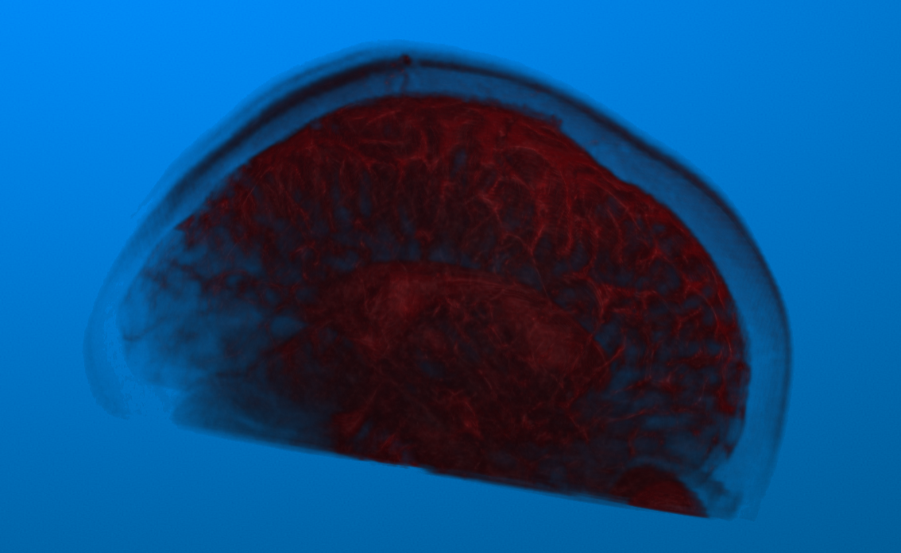
Comparison between views
Isosurface - Surface rendering
Point Cloud - Volume rendering
Matlab, 2023
Matlab, 2023
Notes:
Now, comparing the two techniques:
Surface rendering – solid - Its limitations - closest to the viewer. - sensitivity to sampling and aliasing errors.
Volume rendering consists of one or more fields in 3D - the entire volume directly; less likely to be hidden, good for objects with complex interior structure and no solid boundaries plus transparency and color options - cannot be exportable – more realistc
When comparing - This can result in false positives or false négatives - Given a choice, preference leans toward volume rendering.

Slide 15

Suggestion exercises for modifications
Volume rendering:
Ray casting
Splatting
Surface rendering:
Isosurficing
Isosurface:
Try to use Gaussian filter to better visualization instead Median filter.
Try to use Dual contouring instead of Marching Cube algorithm (sharp edges and corners).
Think in a way to remove the skull completely.
Plus:
Active Contour Models(snakes)
Topological methods
Machine Learning approaches
Deep Learning
3D and Volumetric CNN
Notes:
Selecting an isosurface segmentation technique, consider the specific characteristics of dataset, depending on noise levels, data resolution, and the complexity of the structures.

Slide 16
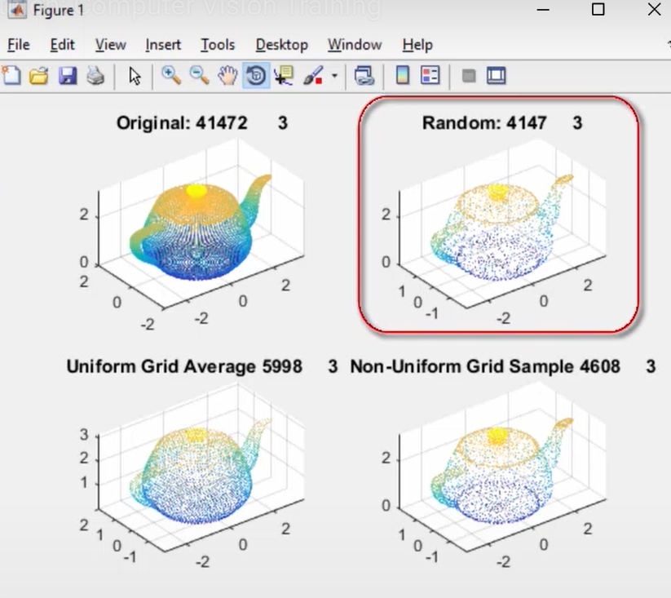
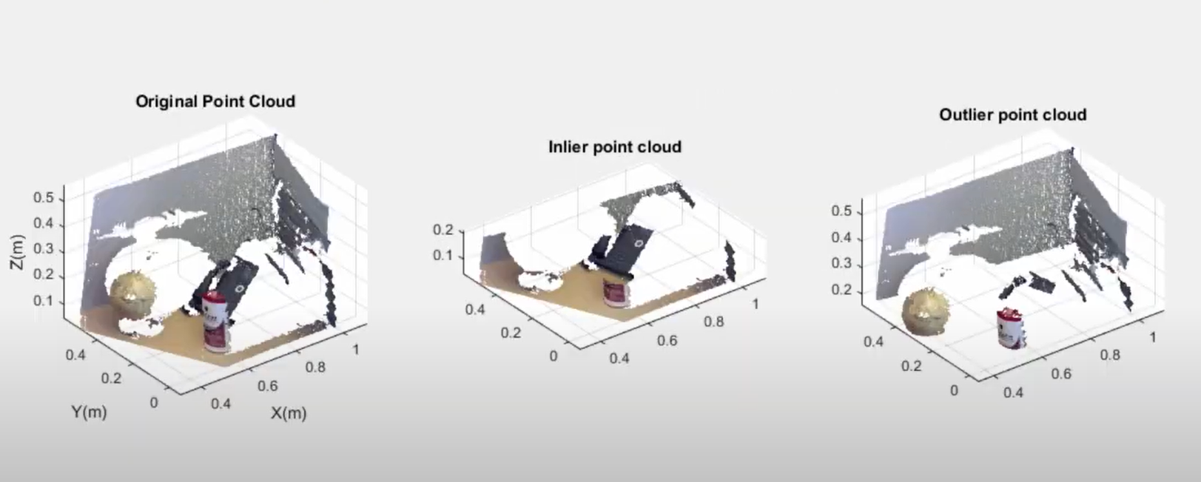
Suggestion exercises for modifications
Point Cloud:
Try to use Downsampling (Random, … Non-Uniform Grid Sample - the best)
Try to use Extraction ROI (Outlier this time).
Matlab, 2023
Matlab, 2023

Slide 17
References
Volume rendering. https://ch.mathworks.com/help/images/explore-3-d-volumetric-data-with-volume-viewer-app.html. Accessed on 07 December 2023.
Matlab. Point Cloud. https://ch.mathworks.com/help/vision/ref/pointcloud.html. Accessed on 12 December 2023.
Matlab. Point Cloud processing. https://ch.mathworks.com/help/vision/point-cloud-processing.html?searchHighlight=point%20cloud&s_tid=srchtitle_support_results_2_point%20cloud. Accessed on 12 December 2023.
Matlab. Explore 3D volume data with volume viewers..https://ch.mathworks.com/help/images/explore-3-d-volumetric-data-with-volume-viewer-app.html. Accessed on 12 December 2023.
Matlab. Point Cloud - Youtube. https://www.youtube.com/watch?v=pLCjjsVGlg0&list=PLn8PRpmsu08rRQCE6npmeMdavaQ5GV1mg&index=10. Accessed on 07 December 2023.
https://www.heavy.ai/technical-glossary/volume-rendering#:~:text=Surface%20rendering%20relies%20on%20determining,technique%20affect%20volume%20rendering%20quality.Accessed on 12 December 2023.
Visualization. PDF from professor include. 2023.
Medical Processing. BOOK here too. 2023.

Slide 18

Notes:
Thanks

Slide 19
Pre-processing steps summary
Isosurface - Surface rendering
Smoothing - Median filter.
Extraction of the Isosurface.
Point Cloud - Volume rendering
Threshold segmentation.
Extraction ROI (Inlier - surface of interest).
Notes:
To summary the Pre-processing steps used were – Read slide!

Slide 20
Volume Rendering - main functions
normalize the intensity value
% normalize the intensity values of the image data to a standard range [0,1]
volume3D = rescale(volume3D);
Create colormap and map for transparency
colormap = [linspace(0, 1, 256)', zeros(256, 2)];
alphaMap = linspace(0, 1, 256).^2;
% square: making lower intensities more transparent
Volume Rendering
h = volshow(volume3D, 'Colormap', colormap, 'Alphamap', alphaMap);
Notes:
% colormap has three channels. We set the green and blue channel to be zero
% using this colormap, we can render higher intensity values in red

Slide 21
Volume Rendering

